Slide 1
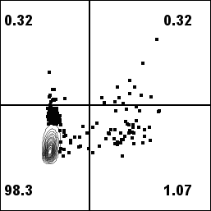
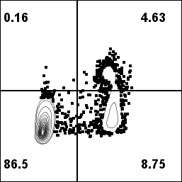
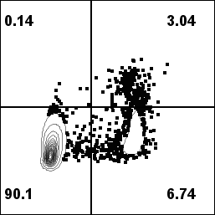
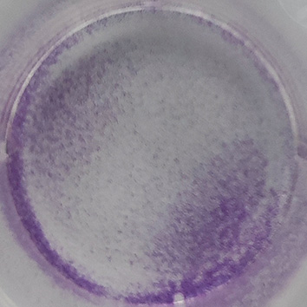
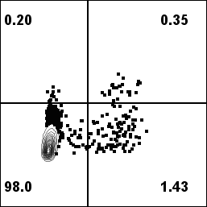
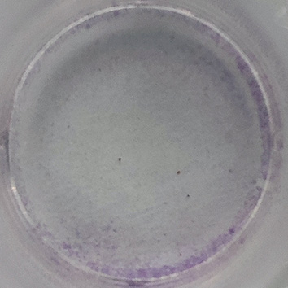
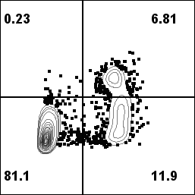
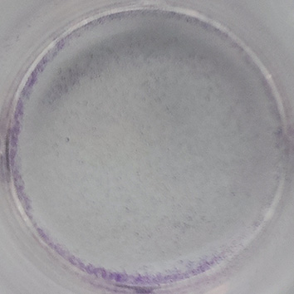
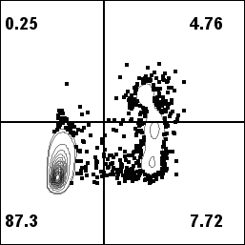
A
si-NC
si-CLP36#1
si-CLP36#2
B
Apoptosis Ratio
Compared to si-NC
BJAB
PI
C
si-NC
si-CLP36#1
si-CLP36#2
D
Apoptosis Ratio
Compared to si-NC
RA 1
PI
Annexin V
Annexin V
Annexin V
E
BJAB
RA 1
F
BJAB
RA 1
Relative BAX Expression
Compared to si-NC
Relative BAX Expression
Compared to si-NC
Relative CASP3 Expression
Compared to si-NC
Relative CASP3 Expression
Compared to si-NC

